Slide 1

Full-Stack Software
Development

Slide 2


Lecture on: Operators and Conditionals

Slide 3

Course Roadmap
Introduction to Java
Operators and Conditionals
Loops and Methods
Strings and Arrays

Slide 4

Yesterday’s Agenda
1
Introduction to Java
2
Java Development Tools
3
Advantages of Java
4
Main Method
5
Variables in Java
6
Printing Values

Slide 5
Today’s Agenda
1
Operators and Their Types
2
Expressions and Statements
3
Operator Precedence and Associativity
4
Conditionals in Java
5
Ternary Operator

Slide 6
Yesterday’s Homework
You are designing an asset tracking system that allows the user to enter the following details of an asset:
Asset tracking number: It is an integer used to identify the asset.
Asset name: It is the name of the asset.
Asset value: It denotes the price of the asset. An asset value can be 980.75.
Write a program that takes the aforementioned inputs from the user and prints them on the console.
Input Format: a.The first line contains the asset tracking number, which is an integer b. The second line contains the asset name, which is a string c. The third line contains the asset value, which is a float number
Output Format: a. The first line contains the asset tracking number input by the user b. The second line contains the asset name input by the user c. The third line contains the asset value input by the user

Slide 7
Yesterday’s Homework Solution
package com.company; import java.util.Scanner; public class Main { public static void main(String args[]) { Scanner sc = new Scanner(System.in); int assetTrackingNumber = sc.nextInt(); String assetName = sc.next(); float assetValue = sc.nextFloat(); System.out.println(assetTrackingNumber); System.out.println(assetName); System.out.println(assetValue); } }

Slide 8

What Is an Operator?
You are aware of the variables and the the various ways in which they can be initialised. However, only declaring and initialising the variables is not enough. How do you play around with these variables or get something done?
An operator is a symbol that performs an operation on a variable(s).
Operators are used to perform operations such as addition, subtraction and value inversion.
“+”, “*” and “!” are some examples of operators.

Slide 9
Types of Operators
Java offers the following types of operators:
a. Arithmetic Operators
b. Assignment Operators
c. Unary Operators
d. Equality and Relational Operators
e. Logical Operators
f. Bitwise Operators

Slide 10

Arithmetic Operators
In your daily life, you perform various arithmetic operations such as calculating the total cost of the products that you buy from a grocery store.
In Java, arithmetic operators are used for addition, subtraction, multiplication and division.
We use +, -, *, / and % for addition, subtraction, multiplication, division and remainder, respectively.
In case of multiplication, general BODMAS rules are followed.
Note:
An operation performed on variables of int data type will always return an int value and hence can lead to information loss.
You should always use appropriate data types in the first place depending on your purpose to avoid loss of information.

Slide 11
Arithmetic Operators
public class Main { public static void main(String[] args) { int a = 10; double b = 15.45; //Addition System.out.println(a+b); //25.45 //Subtraction System.out.println(a-b); //-5.449999999999999 //Multiplication System.out.println(a*b); //154.5 //Division System.out.println(b/a); //1.545 //Remainder System.out.println(b%a); //5.449999999999999 } }

Slide 12
Assignment Operator
The most common operator that you will use is the assignment operator.
The assignment operator “=” is used to assign a value to an operand.
It can also be used to assign object references*.
public class Main { public static void main(String[] args) { int a = 10; double b = 15.45; int c = a+b; //25 String message = "Hello There!"; } }
*You will learn about this in detail in the course on Object-Oriented Analysis and Design.

Slide 13
Unary Operators
Unary operators are the operators that require only one operand.
They perform operations such as increment, decrement and value inversion.
Let’s take a look at each unary operator with an example.
Unary Positive: It indicates that a number is positive. Note: A number is positive regardless of whether the + symbol is present or not.
Operator | Description
+ | Indicates that a number is positive
- | Indicates that a number is negative
++ | Increments a value by 1
-- | Decrements a value by 1
! | Inverts the value of a boolean
Unary Operators
//+ Operator int a = +1; System.out.println(a); //1

Slide 14
Unary Operators
2. Unary Negative: It indicates that a number is negative. It converts a negative number to a positive one.
3. Increment: It increases the value of a number by 1. It can be used in the following two ways:
Pre-increment: It is placed before the operand and increments the value instantly.
//- Operator int a = -1; System.out.println(a); //-1
b. Post-increment: It is placed after the operand, and the value of the operand is increased instantly, but the previous value is retained until the execution of the statements.
//Pre-Increment int a = 1; ++a; System.out.println(a); //2
//Post-Increment int b= -1; b++; System.out.println(b); //0

Slide 15
Unary Operators
4. Decrement: It decreases the value of a number by 1. It can be used in the following two ways:
Pre-decrement: It is placed before the operand and decrements the value instantly.
Post-decrement: It is placed after the operand, and the value of the operand is decreased instantly, but the previous value is retained until the execution of the statements.
5. Inversion: It is used to invert the value of a boolean.
//Value inversion Boolean value = true; System.out.println(!value); //false
//Pre-Decrement int a = 1; --a; System.out.println(a); //0
//Post-Decrement int b= -1; b--; System.out.println(b); //-2

Slide 16
Relational Operators
Relational operators are used to determine the relation between two operands such as greater than, less than or equal to.
The two operands are compared, and the result returns a boolean value.
There are six types of relational operators as mentioned below.
Equal-to (==) operator: The equal-to operator is used to determine whether or not two numbers are equal to each other.
Note: You must use "==" and not "=" when testing whether or not two primitive values are equal.
//Equality Operator int a = 1; int b = 2; System.out.println(a==b); //false

Slide 17
Relational Operators
2. Not-equal-to (!=) operator: The not-equal-to operator is used to determine whether two numbers are not equal to each other.
3. Greater than (>) operator: The greater than operator is used to determine whether or not one operand is greater than another one.
//Not Equal to Operator int a = 1; int b = 2; System.out.println(a!=b); //true
//Greater than Operator int a = 1; int b = 1; System.out.println(a>b); //false

Slide 18
Relational Operators
4. Greater than or equal to (>=) operator: The greater than operator is used to determine whether or not one operand is greater than another one.
5. Less than (<) operator: The less than operator is used to determine whether or not one operand is less than another one.
//Greater than or equal to Operator int a = 1; int b = 1; System.out.println(a>=b); //true
//Less than Operator int a = 1; int b = 1; System.out.println(a<b); //false

Slide 19
Relational Operators
6. Less than or equal to (<=) operator: The less than or equal to operator is used to determine whether or not one operand is less than or equal to another one.
//Less than or equal to Operator int a = 1; int b = 1; System.out.println(a<=b); //true

Slide 20
Logical Operators
Logical operators take boolean data type as input and give an output of the same data type.
These operators help in condensing a condition into fewer lines, which simplifies your code.
They are used extensively for decision-making.
Now, let’s take a look at the logical operators in Java, which are as follows:
Logical AND (&&) Operator: The AND operator returns true only if both the conditions are true. Even if one condition is false, the operator will return false.
Syntax: condition1 && condition2
Logical OR (||) Operator: The OR operator returns true if any one of the conditions is true. Even if one condition is false, the operator will return true.
Syntax: condition1 || condition2
Logical NOT(!) Operator: As you learnt in the section on unary operators, the NOT operator returns true if the given condition is not true.
Syntax: !(condition)

Slide 21
Logical Operators
public class Main { public static void main(String[] args) { int a = 10; int b = 12; int c = 30; //AND Operator System.out.println(a<b && c<b); //false //OR Operator System.out.println(a<b || c<b); //true //NOT Operator System.out.println(!(a<b)); //false } }

Slide 22
Bitwise Operators
Bitwise operators are used to perform operations on the individual bits of a number.
They can be used with various data types such as int, char and byte.
They are not used frequently in coding.
Let’s take a look at the bitwise operators in Java, which are as follows:
Bitwise AND (&) Operator: The bitwise AND operator returns 1 only if both the bits are 1. Otherwise, it returns 0.
Bitwise OR (|) Operator: The bitwise OR operator returns 1 if any one of the bits is 1. Otherwise, it returns 0.
Bitwise XOR (^) Operator: The bitwise XOR operator returns 1 if any both bits are same (0 or 1). Otherwise, it returns 0.
Bitwise Complement (~) Operator: The bitwise complement operator returns the reversed value of an input bit. If the input bit is 0, then it will return 1, and if it is 1, then it will return 0.

Slide 23
Bitwise Operators
x | y | x && y | x || y
true | true | true | true
true | false | false | true
false | true | false | true
false | false | false | false

Slide 24
Bitwise Operators
public class Main { public static void main(String[] args) { int a = 10; int b = 12; int c = 30; //Bitwise AND Operator System.out.println(a & b); //8 //Bitwise OR Operator System.out.println(a | b); //14 //Bitwise XOR Operator System.out.println(a ^ b); //6 //Complement Operator System.out.println(~c); //-31 } }

Slide 25



Poll 1 (15 sec.)
What will be the output of the following code?
True
2
Compilation error
None of the above
int a = 2; int b = 2; System.out.println(a=b);
Practice in teams of 4 students
Industry expert mentoring to learn better
Get personalised feedback for improvements
25

Slide 26
Poll 1 (Answer)
What will be the output of the following code?
True
2
Compilation error
None of the above
int a = 2; int b = 2; System.out.println(a=b);
Practice in teams of 4 students
Industry expert mentoring to learn better
Get personalised feedback for improvements
26

Slide 27
Poll 2 (15 sec.)
What will be the output of the following code?
01
-11
11
09
int a = 10; int b = ~a; System.out.println(b);
Practice in teams of 4 students
Industry expert mentoring to learn better
Get personalised feedback for improvements
27

Slide 28
Poll 2 (Answer)
What will be the output of the following code?
01
-11
11
09
int a = 10; int b = ~a; System.out.println(b);
Practice in teams of 4 students
Industry expert mentoring to learn better
Get personalised feedback for improvements
28

Slide 29
Poll 3 (30 sec.)
What will be the output of the following code?
True
False
int a = -12; int b = 2; System.out.println((a/b)>0 && (b>0));
Practice in teams of 4 students
Industry expert mentoring to learn better
Get personalised feedback for improvements
29

Slide 30
Poll 3 (Answer)
What will be the output of the following code?
True
False
int a = -12; int b = 2; System.out.println((a/b)>0 && (b>0));
Practice in teams of 4 students
Industry expert mentoring to learn better
Get personalised feedback for improvements
30

Slide 31
Hands-On Exercise 1
Take two integers as input and perform the following operations on them:
Find their product.
Increment the first number by 1.
Find out the minimum value.
Perform the AND operation between them.

Slide 32
Operator Precedence and Associativity
Precedence and associative rules are used when dealing with equations involving more than one type of operator.
These rules determine which part of the equation is to be considered first, as there can be many different valuations for the same equation.
Operator precedence determines which operator should be evaluated first when there are multiple operators.
In case there are two operators of the same precedence, they are solved according to the associativity rule, i.e., either from right to left or from left to right.
The table in the next slide depicts the precedence of operators in decreasing order, as the magnitude on the top represents the highest precedence and the one at the bottom shows the lowest precedence.

Slide 33
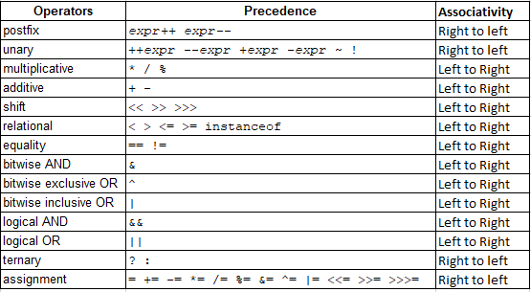
Operator Precedence and Associativity

Slide 34
Poll 4 (30 sec.)
What will be the value of ‘e’ in the following code?
8.0
7.0
3.25
6.0
int a = 2; int b = 3; int c = 4; double e = ++b*c/a;
Practice in teams of 4 students
Industry expert mentoring to learn better
Get personalised feedback for improvements
34

Slide 35
Poll 4 (Answer)
What will be the value of ‘e’ in the following code?
8.0
7.0
3.25
6.0
int a = 2; int b = 3; int c = 4; double e = ++b*c/a;
Practice in teams of 4 students
Industry expert mentoring to learn better
Get personalised feedback for improvements
35

Slide 36
Poll 5 (30 sec.)
What will be the value of ‘e’ in the following code?
2
8
1
None of the above
int a = 2; int b = 3; int c = 4; int e = a^b*c-a;
Practice in teams of 4 students
Industry expert mentoring to learn better
Get personalised feedback for improvements
36

Slide 37
Poll 5 (30 sec.)
What will be the value of ‘e’ in the following code?
2
8
1
None of the above
int a = 2; int b = 3; int c = 4; int e = a^b*c-a;
Practice in teams of 4 students
Industry expert mentoring to learn better
Get personalised feedback for improvements
37

Slide 38
Expressions
An expression is a construct made up of variables, operators and method invocations that evaluates to a single value.
An expression returns a single value, and the data type of the value returned by an expression depends on the elements used in the expression.
In the code given above, ‘a + b’ is an expression.
//Expressions int a = 10; int b = 12; int c; c = a +b;

Slide 39
Statements
A statement forms a complete unit of execution.
You can consider statements as equivalents of English statements.
A statement in Java can be of the following two types:
Declarative Statements: They are used for declaring variables.
Expression Statements: They are expressions terminated by a semicolon (;).
int a = 10;
++a; a--;

Slide 40
Flow Control Statements
Whenever you have to go out, how do you decide which outfit to wear? Let’s take a look at the following general factors that you may usually consider:
Temperature outside
The place that you are going to visit
Your style
Occasion
Your decision is governed by these factors that help you in arriving at a conclusion. Similarly, in programming, we have to make some decisions such as whether a number is even or odd and whether a number is divisible by 2.
We use flow control statements to control the execution of a program based on some predefined conditions.
Java supports the following types of flow control statements:
If
Else
Switch

Slide 41
If Statement
An if statement is the simplest decision-making statement.
It is used to determine whether or not a statement or a group of statements is executed.
There is a condition defined in the if statement, and if that condition is true, then the block is executed; otherwise, it is not executed.
Syntax:
Note:
The condition should always return a boolean value.
If the {} are not provided, then only the statement that is below the if statement would be executed.
if(condition) { //statement(s) to be executed when the condition is met }

Slide 42
Poll 6 (30 sec.)
Which line in the following code is a statement?
1
2
3
There is no statement in the code
float a; //1 a = 12.5f; //2 double b = a; //3
Practice in teams of 4 students
Industry expert mentoring to learn better
Get personalised feedback for improvements
42

Slide 43
Poll 6 (Answer)
Which line in the following code is a statement?
1
2
3
There is no statement in the code
float a; //1 a = 12.5f; //2 double b = a; //3
Practice in teams of 4 students
Industry expert mentoring to learn better
Get personalised feedback for improvements
43

Slide 44
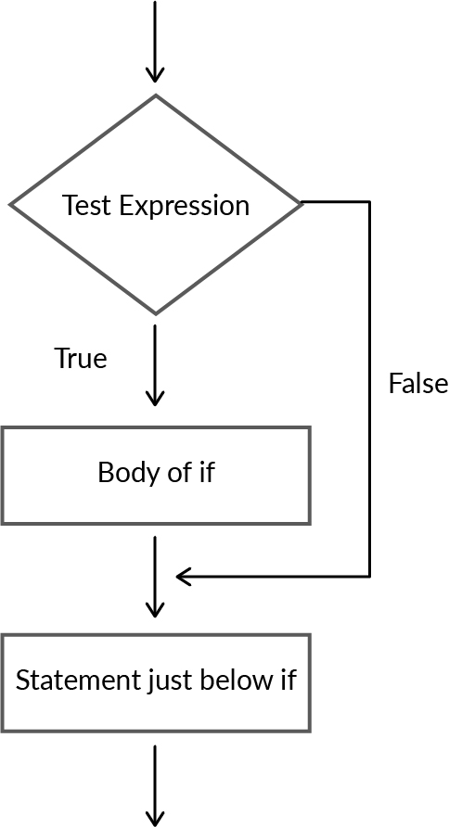
If Statement: Execution

Slide 45
if Statement
package com.company; import java.util.Scanner; public class Main { public static void main(String[] args) { //if Statement int a = 10; Scanner sc = new Scanner(System.in); int b = sc.nextInt(); if(a<b) System.out.println("b is greater"); } }

Slide 46
If-Else Statement
The if statement has only one condition, which, if true, executes some statements; otherwise, it does not.
There are cases when we need to execute something else in case the if condition is not satisfied.
The else statement is used to specify what is to be done in case the if condition is not satisfied.
Syntax:
if(condition){ //statement(s) to be executed when the condition is met } else { //statement(s) to be executed when the if condition is not met. }

Slide 47
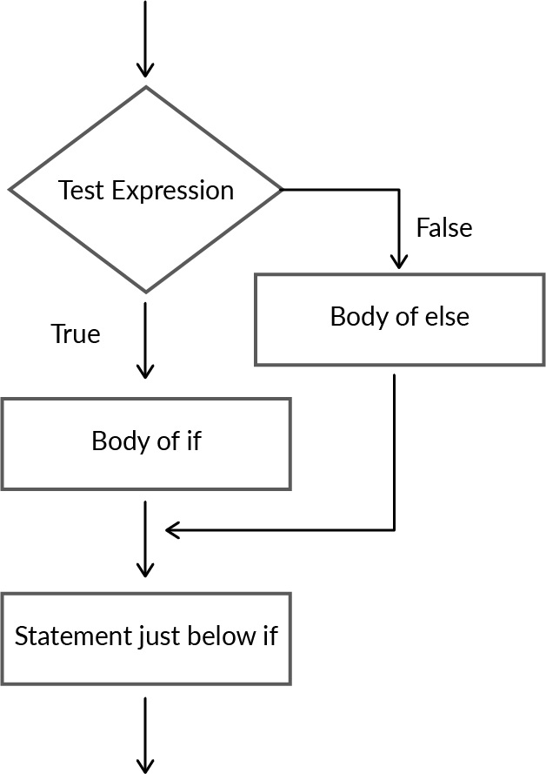
If-Else Statement: Execution

Slide 48
If-Else Statement
public class Main { public static void main(String[] args) { //if - else statements int a = 2; Scanner sc = new Scanner(System.in); int b = sc.nextInt(); if(a<b) System.out.println("b is greater"); else System.out.println("a is greater"); } }

Slide 49
Hands-On Exercise 2
Take a number as an input from the user and find out whether the number is even or odd.

Slide 50
Else-If Statement
So far, we have seen cases with only two options, i.e., either the if condition gets satisfied or the else statement is executed.
However, there could be cases where we have more than two options. For example, whether a number is positive, zero or negative.
In such cases, we use the else-if statement for checking the conditions. Only those statements inside the conditional block whose condition is satisfied are executed.
If none of the conditions is satisfied, then the else block is executed.
Syntax:
if(condition1){ //statement(s) to be executed when the condition is met } else if(condition 2) { //statement(s) to be executed when the condition 2 is met. } else if(condition 3) { //statement(s) to be executed when the condition 3 is met. } else { //statement(s) to be executed when none of the conditions is met. }

Slide 51
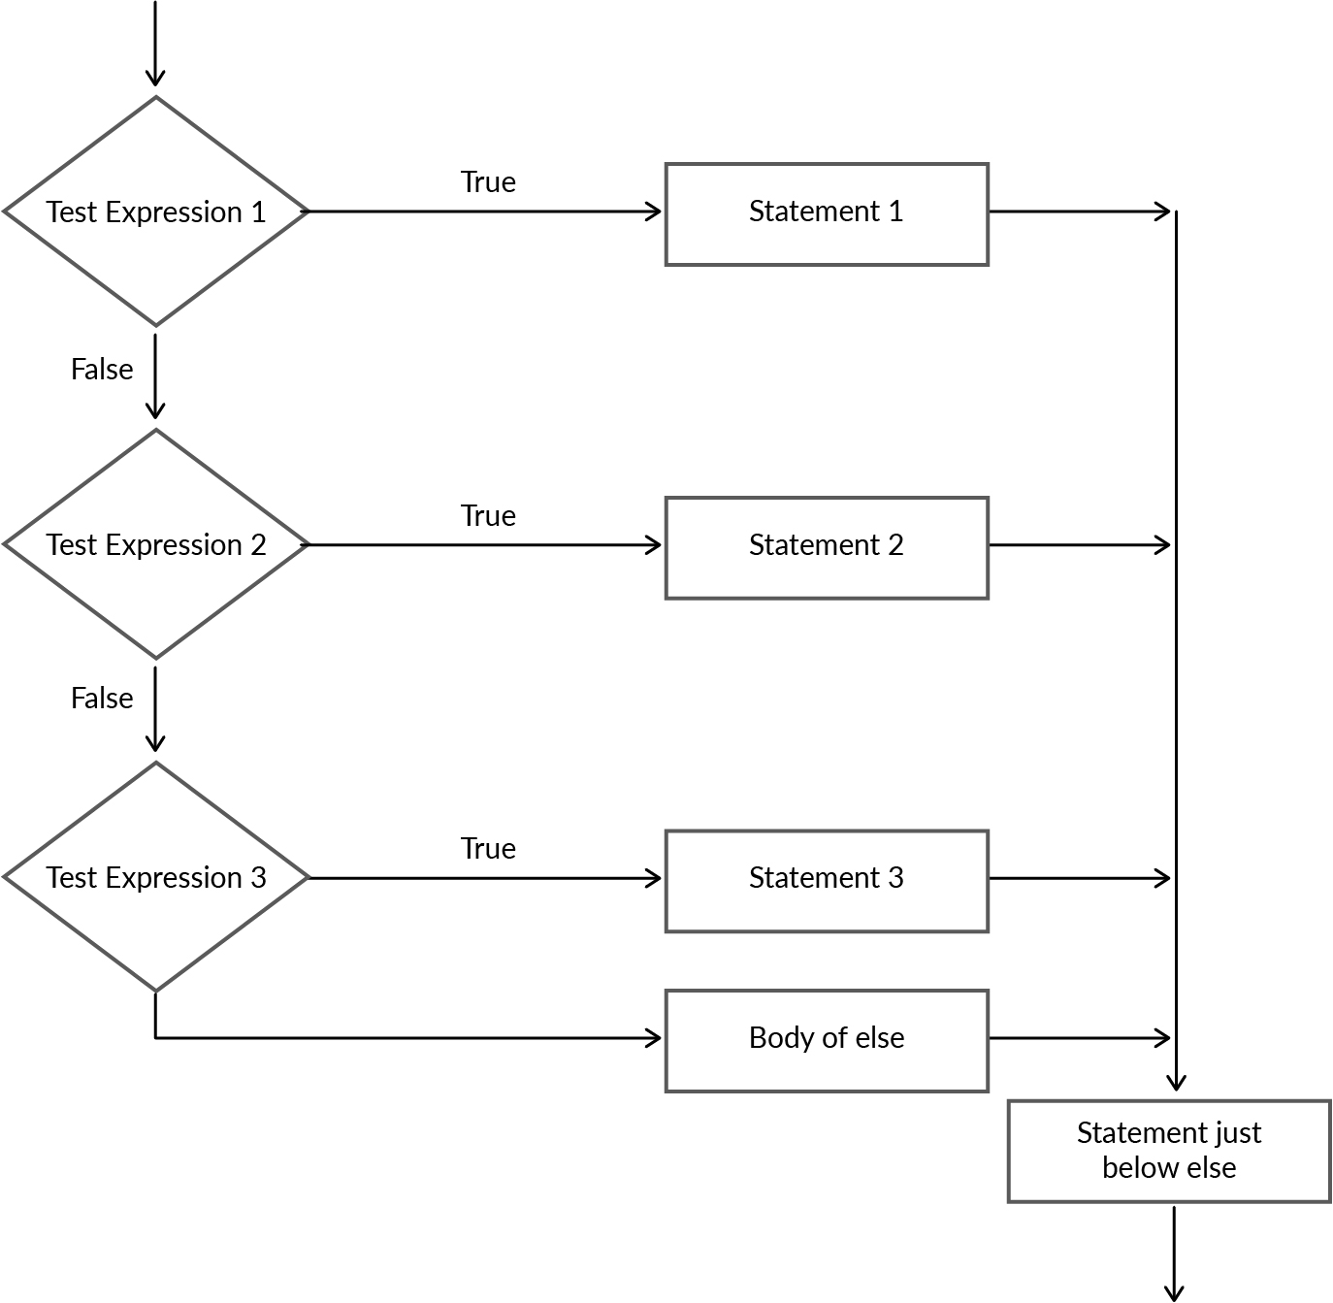
Else-If Statement: Execution

Slide 52
Else-If Statement: Execution
public class Main { public static void main(String[] args) { //if - else Statements Scanner sc = new Scanner(System.in); int a = sc.nextInt(); if(a > 0) { System.out.println("a is a positive number"); } else if( a < 0) { System.out.println("a is a negative number"); } else { System.out.println("a is zero"); } } }

Slide 53
Hands-On Exercise 3
Write a program that decides whether a person is diabetic or not depending on their sugar level as per the following ranges:
If less than 100 and fasting - normal
If less than 130 before a meal - normal
If less than 180 after taking a meal - normal
If none of the above - diabetic

Slide 54
Nested If-Else Statement
Suppose you want to buy an ice cream from a local shop near your house. You would probably follow the below steps:
Go to the shop
Ask for ice cream
Select the flavour
Pay the price
Now, what if the shopkeeper is out of ice cream? Would you still execute the next steps? No.'There are situations where you are not required to execute all the conditions to arrive at a decision. Another example would be checking whether a number is divisible by 8. If the number is not divisible by 2, then it means that it is not divisible by 8.
For such cases, we use the nested if-else statements. ‘Nested if-else’ basically means that there is an if-else statement inside another if-else statement.

Slide 55
Nested If-Else Statement
Syntax:
if (condition1) { if (condition1A) { Action1A; } else { Action1B; } } else { Action2; } }

Slide 56
Hands-On Exercise 4
An online car rental application has the following steps to rent a car:
Is the user looking to rent a car in Mumbai?
If yes, is the number of hours requested by the user greater than 3?
If yes, is the total bill higher than ₹300?
If yes, the car is booked.
Otherwise, the car is not booked.
Write a program that takes the following inputs from the user:
Whether they are looking to rent a car in Mumbai
Number of hours for which the car is needed
Note: The bill is calculated by multiplying the number of hours by 100.

Slide 57
Switch-Case Statement
Consider a scenario of grading students in a college. A student can have one of the fixed grades depending on his/her marks.
In situations like these where there are multiple fixed alternatives, we can use a switch-case statement.
Thus, switch-case statements help us to solve everyday life scenarios that require us to choose between different alternatives.
A switch-case statement executes different parts of code based on the value of an expression.
Expression can be of type byte, short, int, char, enumeration or String.
We use the break statement to terminate the sequence.
There is also a default statement that is similar to the else statement.

Slide 58
Switch-Case Statement
Note:
Duplicate case values are not allowed.
The default statement is optional.
The break statement is optional. If omitted, the execution will continue in the next case.
Syntax:
switch (variable) { case match1: Action1; break; case match2: Action2; break; . . . case matchN: ActionN; break; default: DefaultAction; break;

Slide 59
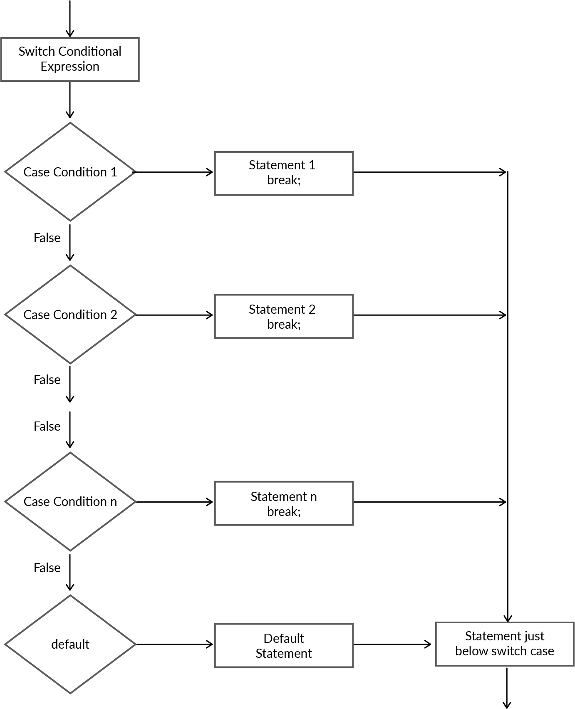
Switch-Case Statement: Execution

Slide 60
Switch-Case Statement
public class Main { public static void main(String[] args) { String light = "Green"; String lightString; switch (light) { case "Green": lightString = "You can drive"; break; case "Yellow": lightString = "Slow down"; break; case "Red": lightString = "Stop"; break; default: lightString = "Invalid color"; break; } System.out.println(lightString); } }

Slide 61
Hands-On Exercise 4
You want to find out which is the current month on the calendar. Take an integer input from the user and find out which month is it. Note: The default should be January.

Slide 62
Poll 7 (30 sec.)
What would be the output of the following code?
5
5 30
30
None of the above
int num1 = 25; int num2 = 5; char operator = '/'; switch (operator){ case '/': System.out.println(num1 / num2); case '+': System.out.println(num1 + num2); break; case '-': System.out.println(num1 - num2); break; case '*': System.out.println(num1 * num2); break; }
Practice in teams of 4 students
Industry expert mentoring to learn better
Get personalised feedback for improvements
62

Slide 63
Poll 7 (Answer)
What would be the output of the following code?
5
5 30
30
None of the above
int num1 = 25; int num2 = 5; char operator = '/'; switch (operator){ case '/': System.out.println(num1 / num2); case '+': System.out.println(num1 + num2); break; case '-': System.out.println(num1 - num2); break; case '*': System.out.println(num1 * num2); break; }
Practice in teams of 4 students
Industry expert mentoring to learn better
Get personalised feedback for improvements
63

Slide 64
Ternary Operator
The ternary operator (?:) is a conditional statement similar to the if-else statement.
It is a one-liner replacement for the if-then-else statement.
It takes extremely less space and makes the code short.
Syntax: variable x = (expression) ? value if true: value if false
public class Main { public static void main(String[] args) { int x = 10; int y = 12; int maxValue = (x > y) ? x : y; System.out.println(maxValue); //12 } }

Slide 65
Hands-On Exercise 5
Find the absolute value of a number using the ternary operator.

Slide 66
Poll 8 (30 sec.)
Suppose you are designing a colour detector that prints the name of an input colour. There can be only two colours: black and white. If the input colour is black, then you need to print ‘black’, and if the input colour is white, then you need to print ‘white’. Which of the following would be the best to use?
If statement
If-else statement
Switch-case statement
Ternary operator
Practice in teams of 4 students
Industry expert mentoring to learn better
Get personalised feedback for improvements
66

Slide 67
Poll 8 (Answer)
Suppose you are designing a colour detector that prints the name of an input colour. There can be only two colours: black and white. If the input colour is black, then you need to print ‘black’, and if the input colour is white, then you need to print ‘white’. Which of the following would be the best to use?
If statement
If-else statement
Switch-case statement
Ternary operator
Practice in teams of 4 students
Industry expert mentoring to learn better
Get personalised feedback for improvements
67

Slide 68
Poll 9 (30 sec.)
A program needs to make a decision based on the value of an expression. Which of the following would be the best to use for the program?
If statement
If-else statement
Switch-case statement
Ternary operator
Practice in teams of 4 students
Industry expert mentoring to learn better
Get personalised feedback for improvements
68

Slide 69
Poll 9 (Answer)
A program needs to make a decision based on the value of an expression. Which of the following would be the best to use for the program?
If statement
If-else statement
Switch-case statement
Ternary operator
Practice in teams of 4 students
Industry expert mentoring to learn better
Get personalised feedback for improvements
69

Slide 70
Today’s Homework
Find out the largest number among the three given numbers.
Input Format:
The first line contains the first number
The second line contains the second number
The third line contains the third number
Output Format:
The first line contains the value of the largest number
Sample Input 1:
12
4
5
Sample Output 1:
12

Slide 71
Tasks to Complete After the Session
Homework Questions
MCQs
Coding Questions

Slide 72
Next Class
1
Loops in Java with break and continue statements
2
Methods in Java

Slide 73
#RahoAmbitious
Thank you!

